Slide 1
Chapter 7
UNIFIED MODELING LANGUAGE FOR ER DIAGRAM

Slide 2
Objectives
To explain the differences and similarities between UML and ER modeling.
To know how to use UML notation as an alternative to E-R notation

Slide 3
Introduction
UML: Unified Modeling Language
UML has many components to graphically model different aspects of an entire software system
UML Class Diagrams correspond to E-R Diagram, but several differences.
There are some similarities between UML and ER modeling, but also differences in terminologies and semantics
Example: an Entity is modeled as a Class in UML

Slide 4
Mapping of ER Concepts to UML Notation
To use UML, we need to identify the equivalent UML concepts to represent the ER concepts.
Figure below shows the mapping of the terminologies.
ER Model | UML Notation
Entity | Class
Attribute | Attribute
Primary Key | Object Identifier
Not Applicable | Methods
Relationship | Association
Cardinality | Multiplicities
Supertype/Subtype | Inheritance

Slide 5
Entity
In UML, a class is represented by a BOX that has 3 sections: the TOP section gives the class name; the MIDDLE section shows the attributes, and the LAST section shows the operations or methods.
Figure 7.1 shows the Staff entity (Figure 7.1) as a class in UML, excluding the methods and operations that can be applied to the class. (Note: in object oriented design, you will normally see the operations and methods included in the box.)

Slide 6
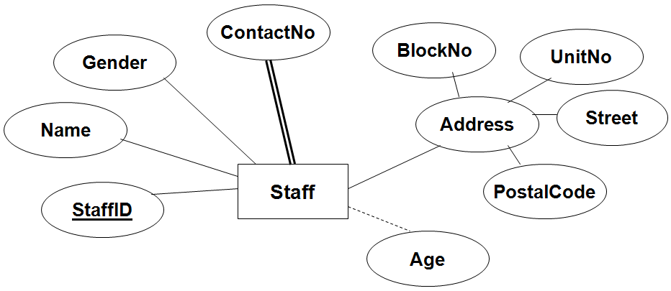
Entity (continued)
Figure 7.1: Staff Entity in ER Diagram

Slide 7
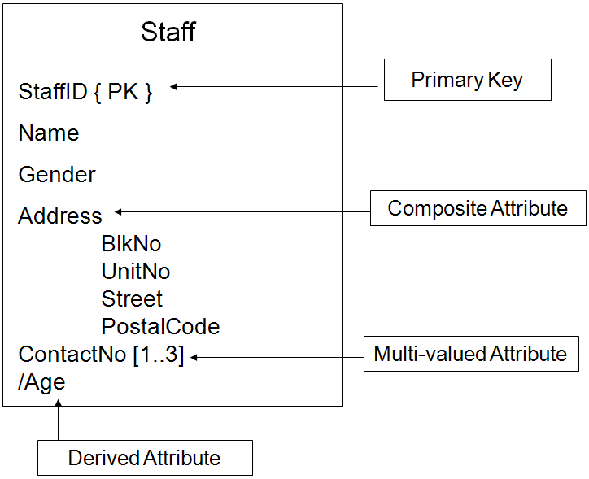
Entity (continued)
Figure 7.2:
Equivalent UML notation for entity

Slide 8
Attributes
A COMPOSITE attribute can be modeled by listing the components below the attribute.
A MULTI-VALUED attribute can be modeled by indicating the lower and upper limits next to the attribute’s name. (A multi-valued attribute can also be modeled as a separate class.)
A DERIVED attribute can be modeled by prefixing a slash(/) to the attribute’s name.

Slide 9
Relationship
Relationship, known as association in UML is represented by a line connecting the participating classes (entities).
The relationship is labeled in one direction, indicated by an arrow next to the relationship name.
The (min, max) notation is used to specify relationship constraints, which are known as multiplicities in UML.
Multiplicities:
  Consists of cardinality and participation constraints.
  Specified in the form min..max, and an asterisk(*) indicates no maximum limit on the participation

Slide 10

Relationship (continued)
The constraint 0..* on the E2 side and 0..1 on the E1 side means that each E2 entity can participate in at most one relationship, whereas each E1 entity can participate in many relationships;
In other words, the relationship is many to one from E2 to E1.
Figure 7.3: UML notation for relationship

Slide 11
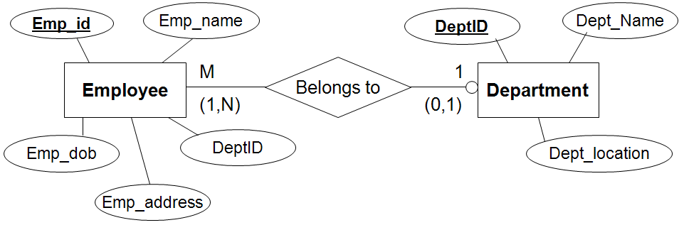
Relationship (continued)
Figure 7.4: Example of ER diagram for relationship

Slide 12
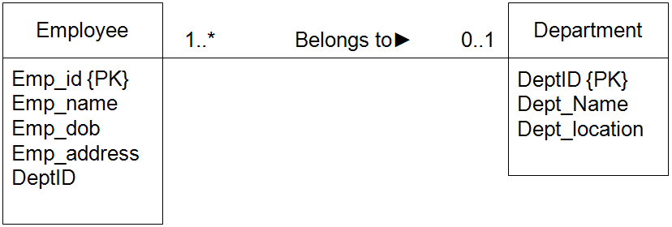
Relationship (continued)
Figure 7.5: Example of UML notation for relationship

Slide 13
Supertype/Subtype
Model using inheritance.
The constraints - disjoint and participation – are represented by adding a description using the {…} brackets.

Slide 14
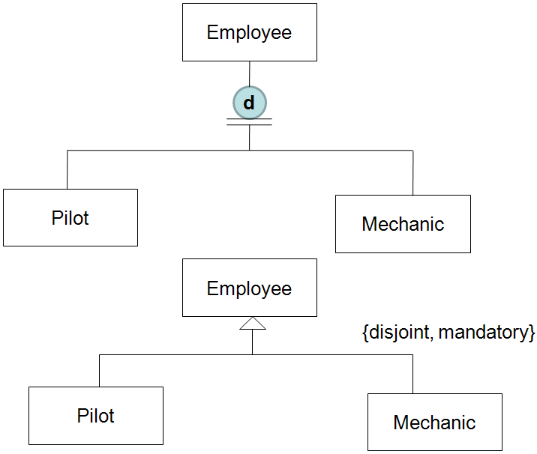
Supertype/ Subtype (continued)
Figure 7.6: Equivalent UML notation for supertype/subtype relationship

